Slide 1
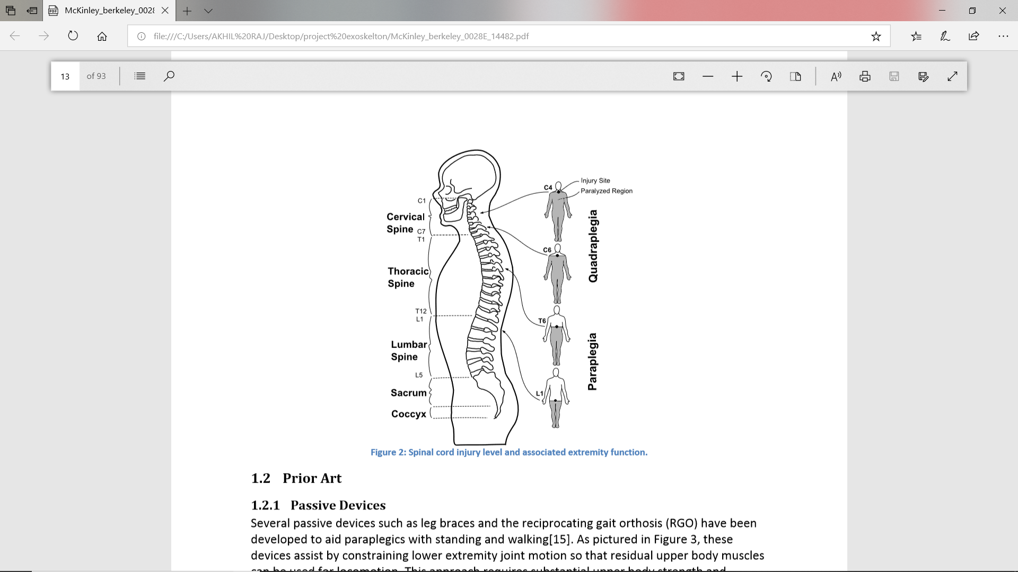
SPINAL INJURY AND IT’S EFFECT
Typically, individuals with higher injuries (upper thoracic or cervical spine) will suffer from increased levels of impairment as they will be left with reduced functionality below their injury level

Slide 2
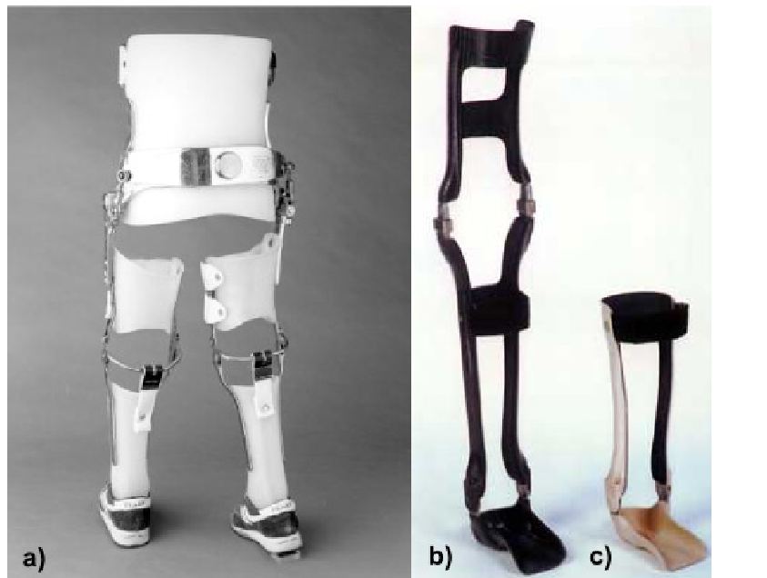
PASSIVE DEVICES

Slide 3
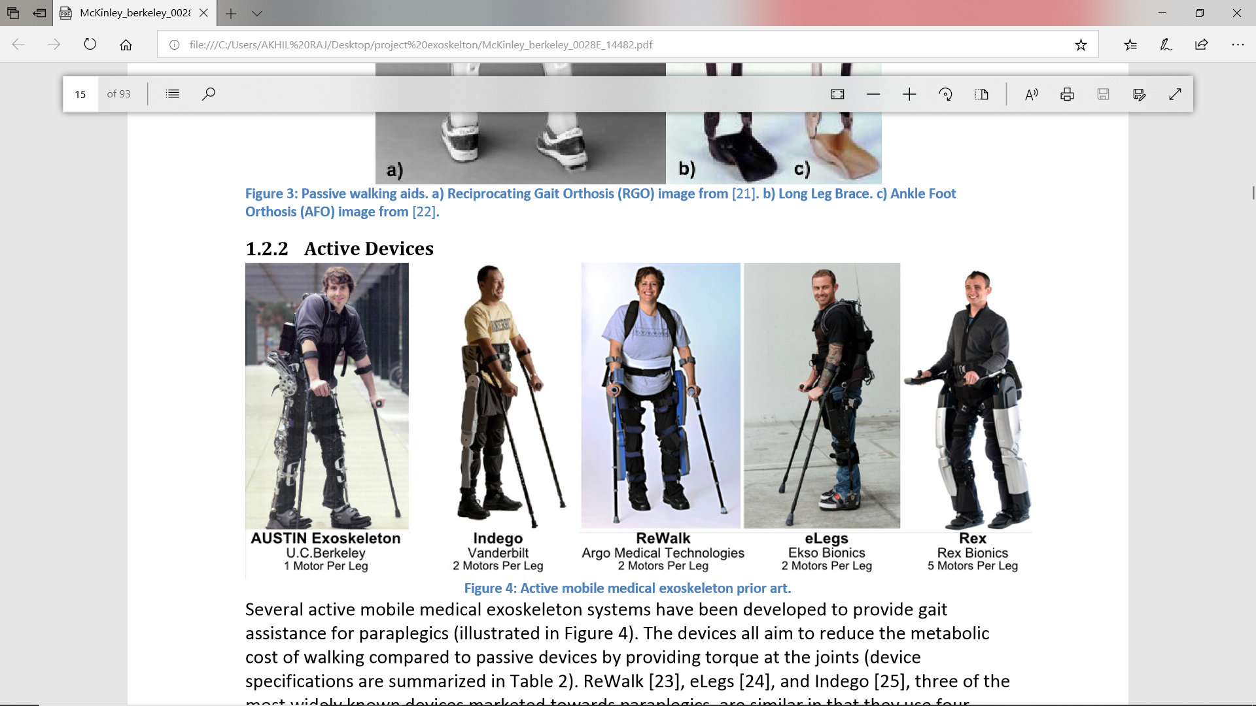
ACTIVE DEVICES
Several active mobile medical exoskeleton systems have been developed to provide gait assistance for paraplegics
The devices all aim to reduce the metabolic cost of walking compared to passive devices by providing torque at the joints
ReWalk [23], eLegs [24], and Indego [25], three of the most widely known devices marketed towards paraplegics

Slide 4
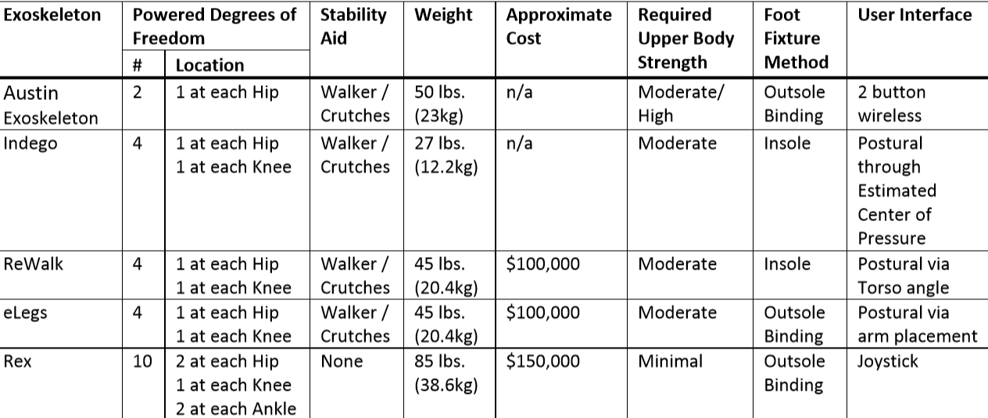
SUMMARY OF ACTIVE MEDICAL EXOSKELETONS

Slide 5
PASSIVE DEVICES
These devices assist by constraining lower extremity joint motion so that residual upper body muscles can be used for locomotion
This approach requires substantial upper body strength and crutches or a walker for balance
Ambulation with the passive device requires up to 14 times more energy
It is possible to reduce the metabolic cost of ambulation with passive orthotics through the introduction of functional electrical stimulation (FES)

Slide 6
METHODOLOGY

Slide 7
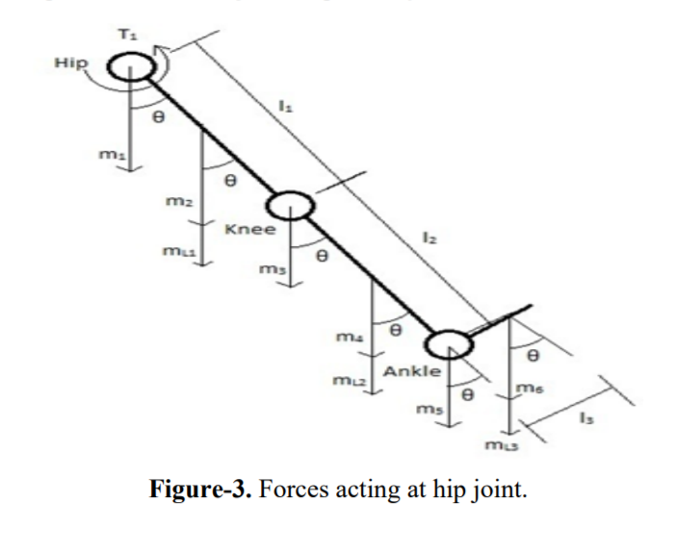

Slide 8
M1=MASS OF THE ACTUATOR AT HIP JOINT
M2=MASS OF THIGH
M3=MASS OF ACTUATOR AT KNEE JOINT
M4=MASS OF SHANK
M5=MASS OF ACTUATOR AT ANKLE JOINT
M6=MASS OF FOOT
ML1=MASS OF THIGH LINK
ML2=MASS OF SHANK LINK
ML3=MASS OF ANKLE LINK
L1=LENGTH OF THIGH
L2=LENGTH OF SHANK
L3=LENGTH OF FOOT
T1=TORQUE REQUIRED AT HIP JOINT
T2=TORQUE REQUIRED AT KNEE JOINT
T3=TORQUE REQUIRED AT ANKLE JOINT

Slide 9
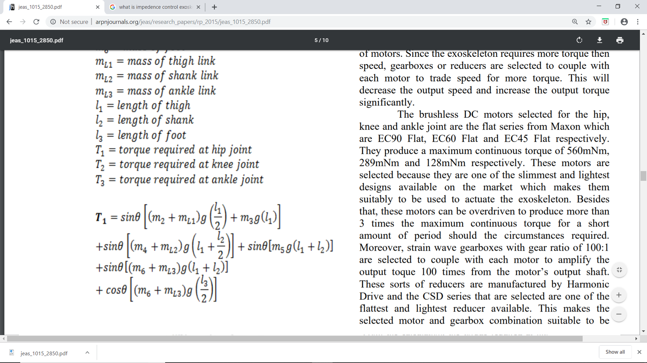
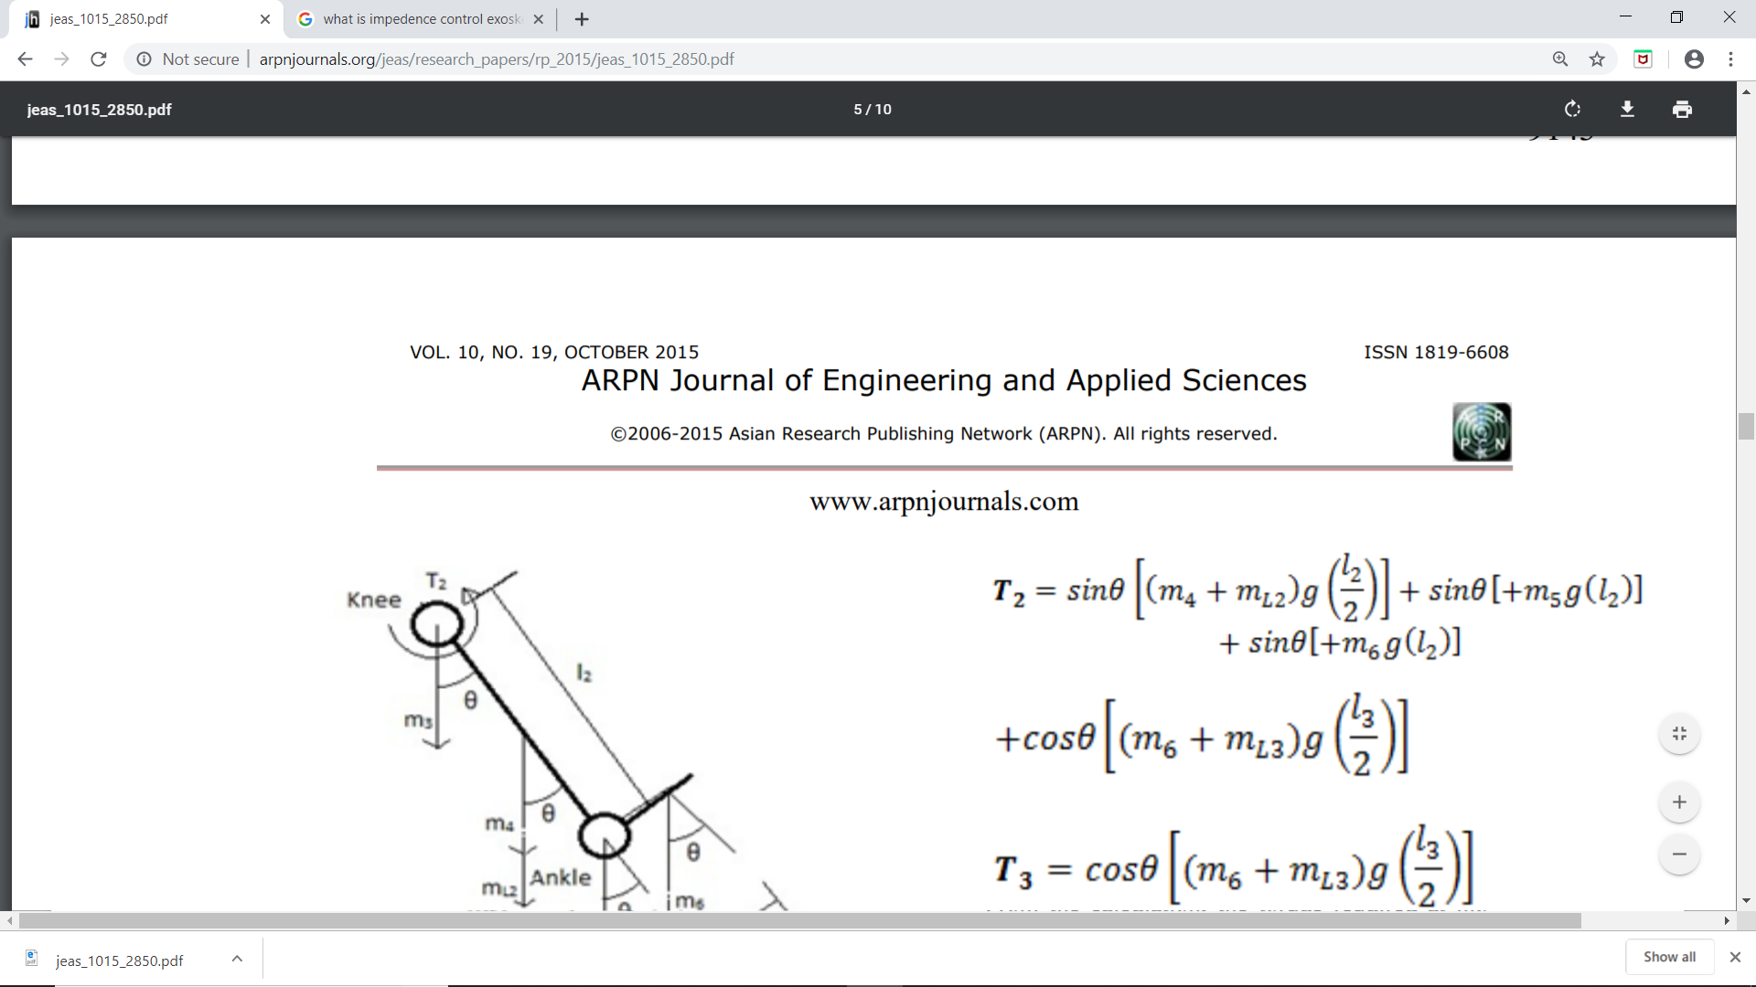

Slide 10
For calculating the torque needed for walking the targeted user to be weighing 100kg and 1.85 m tall
The body segment parameters of the user is obtained from (Drillis, Contini and Bluestein, 1964) and (Khan, 2012).
T1=47.56Nm;T2=21.68Nm;T3=2.10Nm
From the calculation, the torque required at hip joint is 47.56 Nm; the torque required at knee joint is 21.68 Nm whereas the torque required at the ankle is 2.10 Nm.
In this project, stepper motors are selected for their efficiency and longer lifetime compared to other type of motors.
Since the exoskeleton requires more torque then speed, gearboxes or reducers are selected to couple with each motor to trade speed for more torque
The motor and reducer combined to produced 56Nm, 28.9Nm and 12.8Nm at hip, knee and ankle joint respectively

Slide 11
EXOSKELETON DESIGN
The exoskeleton is designed to carry an able bodied and healthy user with a maximum weight of 100kg and height of 185cm
The exoskeleton that includes all the actuator units and links weighs only 6.44kg
It consists of thigh link, shank link and foot pad for each limb of the exoskeleton like the human body.
All the links are connected together by a pivot joint instead of using the actuator unit as the joint as shown.
This design will help in avoiding direct load applied to the motors and reducers which will damage the actuator unit as there are limitations to its overhung load
The braces are to be covered with Velcro straps for easy and fast fastening action.

Slide 12
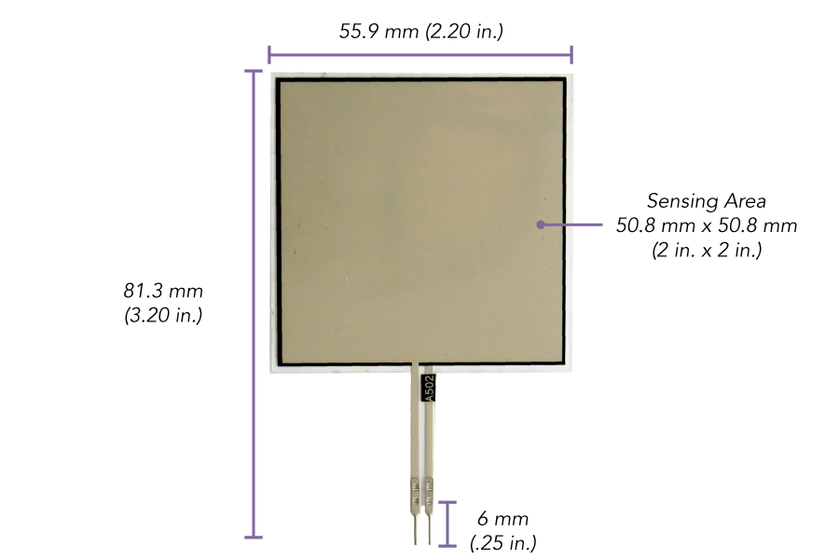
FORCE SENSORS
Suitable force sensors are selected for finding pilot’s motion intention
For this we selected flexi force A502 ultra thin force sensor

Slide 13
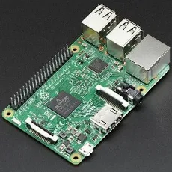

EXOSKELETON CONTROL AND BATTERY SELECTION
For controlling we are using raspberry pi 3 MODB 1GB controller
Lithium polymer rechargeable battery 22.2 V 16000MAH
Raspberry pi 3MODB 1GB
Lithium polymer rechargeable battery 22.2 V 16000MAH

Slide 14
LEG SWING MOTION
Figure 1 shows the torque pattern of hip joint obtained from the simulation
The torque value recorded for hip joint starts at 12.87 Nm initially and then gradually decreased to -21.32 Nm at 0.88 s and then increased to -20.10 Nm at 1.0 s.
The torque value recorded for hip joint starts at 12.87 Nm initially and then gradually decreased to -21.32 Nm at 0.88 s and then increased to -20.10 Nm at 1.0 s. The maximum value of torque in terms of magnitude for hip joint obtained from simulation is 21.32 Nm.
This means that the hip joint actuator unit selected is able to support the user to take a step as the torque required does not exceed the maximum continuous torque of actuator unit which is 56 Nm.

Slide 15
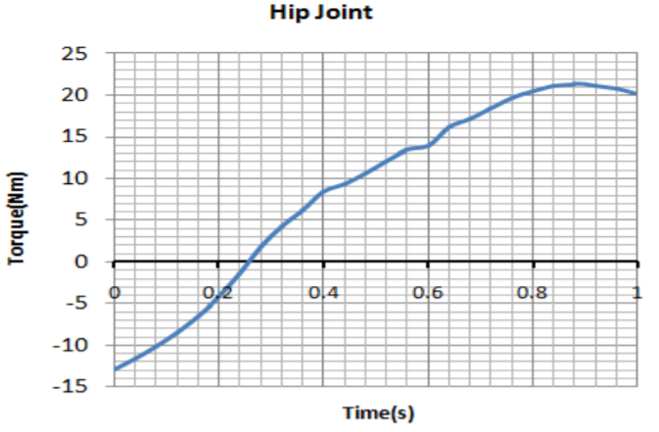
Fig 1

Slide 16
Figure 2 shows the torque pattern of knee joint obtained from the simulation.
The knee joint torque data obtained from simulation shows a gradual increase from 1.16 Nm at 0s to 10.64 Nm at 0.4s and then gradually decrease to -3.37 Nm.
The maximum value for torque values is 9.39Nm.
The maximum value for the simulation does not exceed the maximum continuous torque of the knee joint actuator unit selected which is 28.9 Nm.
This means that the knee joint actuator units selected are able to support the user to take a step forward

Slide 17
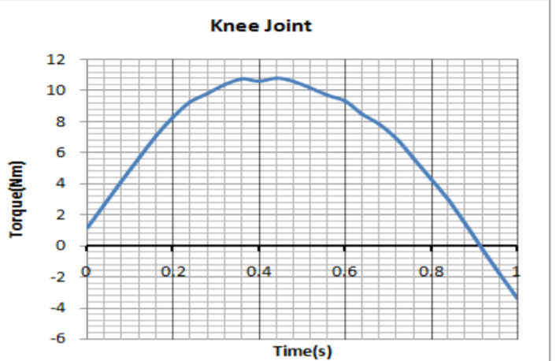
KNEE JOINT
Fig 2

Slide 18
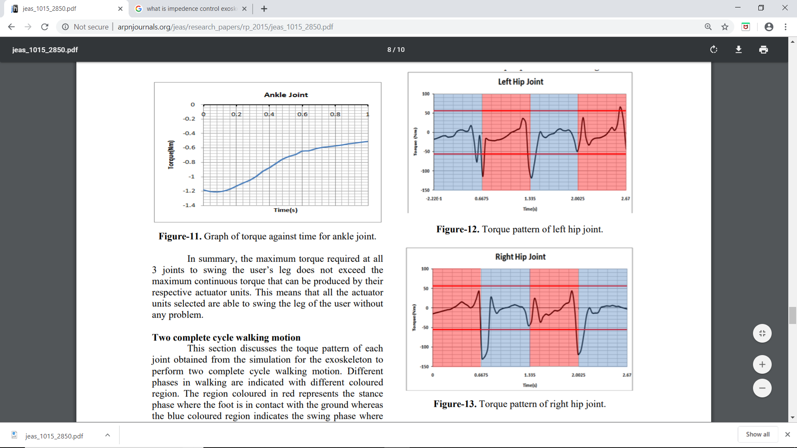
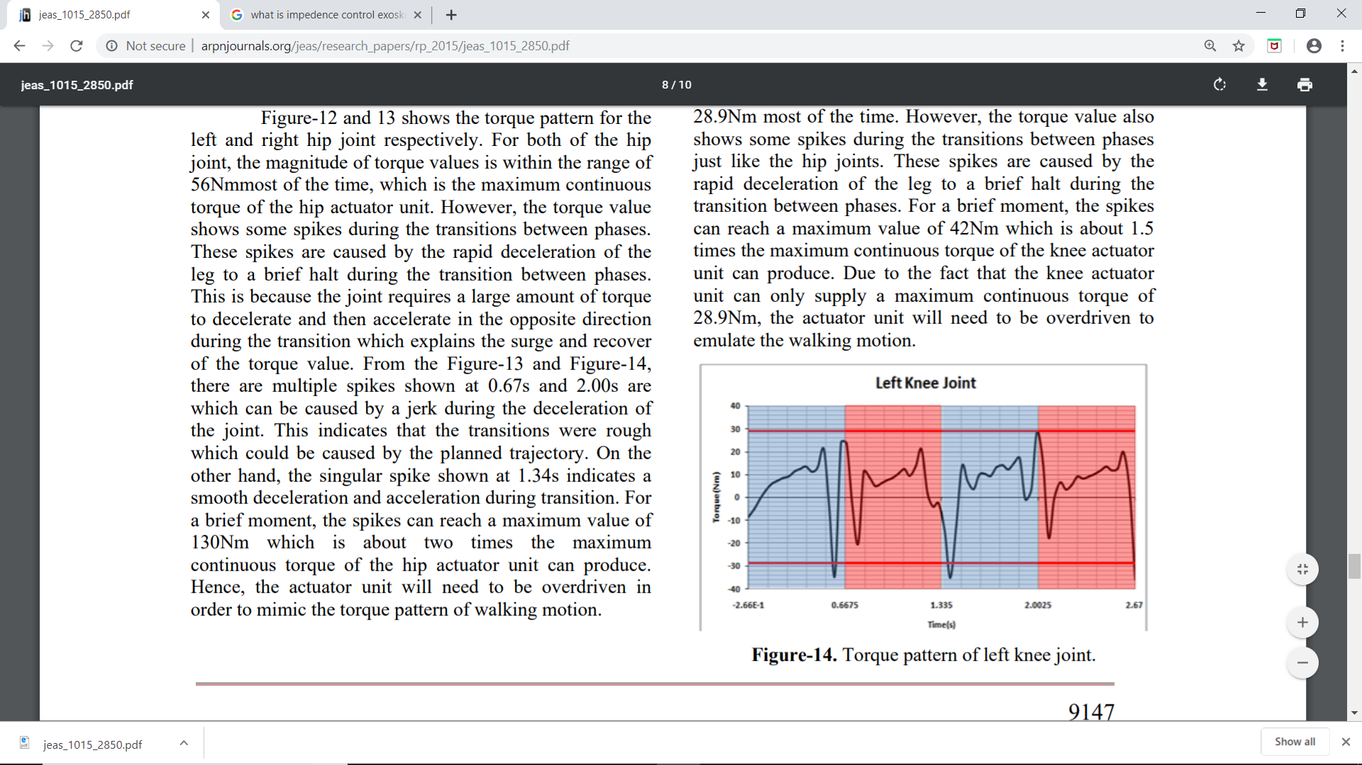
GRAPH SHOWING TWO CYCLE GAIT MOTION

Slide 19
SUMMARY OF THE GRAPH
For a brief moment, the spikes can reach a maximum value of 130Nm which is about two times the maximum continuous torque of the hip actuator unit can produce.
In summary, the actuator units selected are able to actuate the lower limb of the user to walk. However, the hip and knee actuator units will need to be overdriven during transition period between phases in order to mimic the torque pattern of walking

Slide 20
For a brief moment, the spikes can reach a maximum value of 42Nm which is about 1.5 times the maximum continuous torque of the knee actuator unit can produce.
Due to the fact that the knee actuator unit can only supply a maximum continuous torque of 28.9Nm, the actuator unit will need to be overdriven to emulate the walking motion.
In summary, the actuator units selected are able to actuate the lower limb of the user to walk. However, the hip and knee actuator units will need to be overdriven during transition period between phases in order to mimic the torque pattern of walking

Slide 21
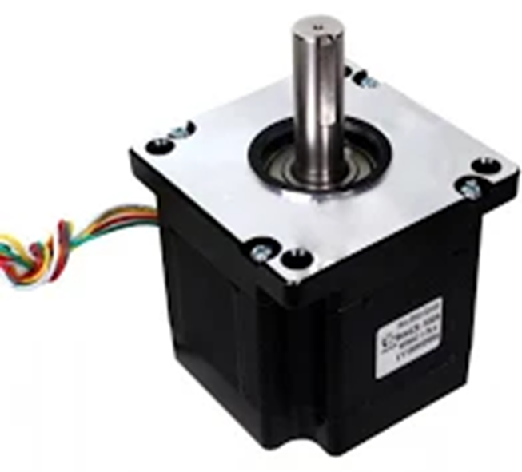
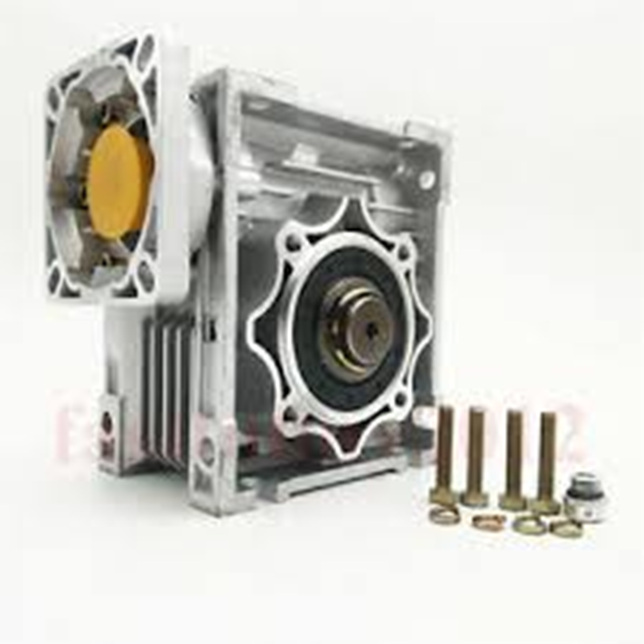


MOTOR
Stepper motor NEMA 42 is selected for providing exoskeleton actuation
NEMA 42 compatible worm gear is used to get desired gear ratio

